Slide 1
Buffer-pool aware Query Optimization
Ravishankar Ramamurthy
David DeWitt
University of Wisconsin, Madison

Slide 2
managing main memory
Main memories are increasing
  Prices declining at about 100x per decade
  Advent of 64-bit machines
  1 TB of main memory feasible
Use a BIGGER buffer pool
  Caching does not automatically guarantee improved performance

Slide 3
problem
Optimizer uses “worst-case” estimates
Selection query on a single table
  Optimizers would choose an unclustered index only for highly selective queries (~0.1%)
  Even if all required pages are cached, optimizer would still pick a table scan

Slide 4
goal
Buffer-pool aware query optimizer
  Benefits ?
  Architecture ?
Focus
  Single table queries
  Foreign-key joins

Slide 5
single table queries
Prototype query engine
  SHORE (320 MB buffer pool, 16 KB pages)
  TPC-H 1 GB database
Selection predicate on Lineitem table (0.5%)
  Unclustered index available for evaluating predicate

Slide 6
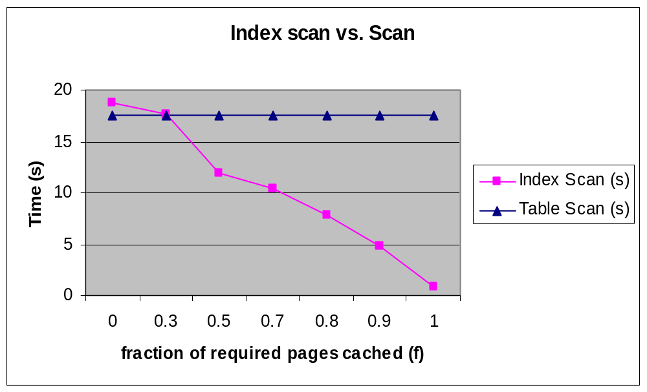

Slide 7
join queries
Join Query between Lineitem and Orders
  range predicate on l_receiptdate
  unclustered index on l_receiptdate
Index alternatives
  Covering Indexes (Cov1, Cov2)
  Join Index on (l_orderkey, o_orderkey)
    Stores (RID1, RID2) pair of joining tuples

Slide 8
JINDEX plan
_{FILTER}
_{PROBE}
_{Join Index}
_{FETCH}
_{(Lineitem)}
_{FETCH}
_{(Orders)}
_{B-Tree}
_{Range Scan}
_{(l_receiptdate)}

Slide 9
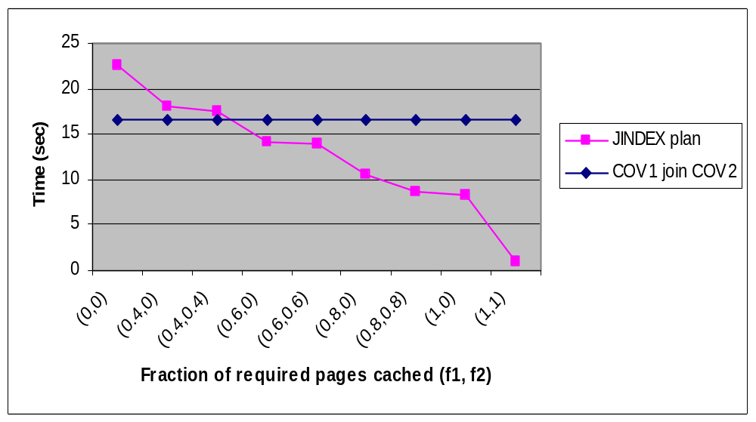
effect of buffer pool

Slide 10
benefits
Similar tradeoff for other combinations
  Index nested loops vs. Sort Merge Join
Relative costs of plans
  Caching can cause a big difference
  Optimizer could miss plans that have much better performance

Slide 11
what is needed ?
Optimizer needs improved cost functions
Given a selection (join) predicate
  What fraction of pages (f) containing tuples that satisfy the predicate is in memory.
  Cost of Index plan = N * (1 – f) * io_cost
Not altering search space

Slide 12
challenges
Parameter f
  function of query and buffer pool state
Simple page count per relation will not suffice
  Different queries require different subsets of pages

Slide 13
solution ?
Assume interface
  bool isCached(RID)
selection (join) predicate
  Optimizer computes RIDs of tuples that satisfy the predicate
  Use isCached() to calculate f.

Slide 14
candidates
Index Pre-execution
  Accurate technique
  High overheads
Sampling techniques
  “close-enough” accuracy
  Low overheads

Slide 15
index pre-execution
Compute RID lists during query optimization
  “pre-execute” predicates on indexes
Selection Predicates
  Unclustered index on required attribute.
  Evaluate predicate only on index pages.
  Use List of RIDs and IsCached() to calculate f.

Slide 16
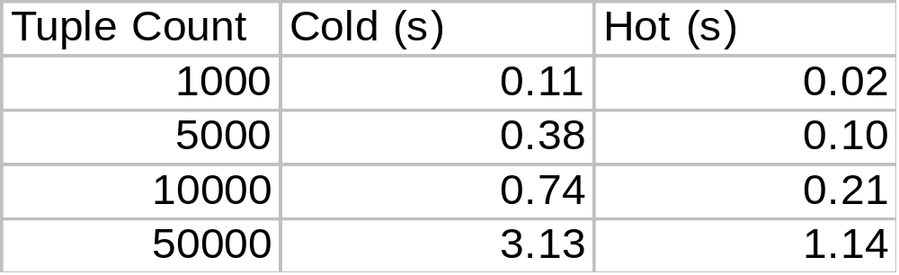
selection predicates
Lineitem table (1 GB TPC-H)
  Range Predicate on l_shipdate column
  Shore B-Tree on l_shipdate column
overhead can be15-20% of scan time

Slide 17
observations
Index pre-execution
  Accurate but not practical
Optimizer should not miss important cases
  Large fraction of required pages are in memory
  How important is accuracy ?

Slide 18

relaxing accuracy
Close-enough (~5%) estimates can suffice
Can sampling help ?

Slide 19
sampling
Select * from R where R.value = 1
f_{actual} = 30/40 = 0.75
f_{estimated} = 3/4 = 0.75
111111111100000000100000000100
111111111100000
001111110010011
11111111110
111111111110000000100000000100
111111111100000
001111110000011
11111111110
111111111100000000100000000100
111111111100000
001111110010011
11111111110
111111111100000000100000000100
111111111100000
001111110010011
11111111110

Slide 20
sampling
Index pre-execution
  Used to gather RID lists that satisfy predicates
Alternative
  Use random samples of RIDs instead
  Pre-compute samples and cache in main memory
  Avoids I/Os during query optimization

Slide 21
selection predicates
Pre-computation
  Samples on base table (table A)
  Reservoir sampling using table scan
  S_{a} stores (Atuple, RID-A) pair
Using the samples
  Evaluate predicate on S_{a}
  Use RID-A samples and isCached() interface to calculate f_{estimated}

Slide 22
experiments
Simulate buffer pool configurations
  Pre-fetch appropriate ranges
  calculate f_{actual}
  calculate f_{estimated} using sampling
Evaluation Metric
  Mean of ABS (f_{actual} - f_{estimated})
  ERR1 (all configurations)
  ERR2 (configurations having f_{actual} > 0.75)

Slide 23
selection predicate
Selection predicate on Lineitem table
  l_shipdate between (1994-01-01,1994-01-11)
Sample Size ERR1 ERR2
6000 7.04% 4.60%
12000 5.91% 3.50%
30000 4.13% 2.57%
60000 4.06% 2.39%

Slide 24
join predicates
Foreign key join between A and B
  A.a is foreign key pointing to B.b.
  Index pre-execution not feasible
  Sampling techniques
Pre-computation for joins
  Assume S_{ab} is pre-computed
  S_{ab} = S_{a} Join B
  stores (RID-A, Atuple, Btuple, RID-B)

Slide 25
using the samples
Join Query between A.a and B.b
  Range predicate on table A
Required
  What fraction of pages of B that satisfies the join predicate is cached (f)
  Cost of Index nested loops join with B as “inner”
Approach
  Evaluate predicate on Sab
  Project RID-B samples that satisfy predicate
  Use RID-B samples and isCached() to calculate f_{estimated}

Slide 26
join predicate
Join between Lineitem and Order
  Predicates on l_receiptdate and l_shipmode
Sample Size ERR1 ERR2
6000 11.68% 7.98%
12000 9.29% 5.99%
30000 5.88% 3.43%
60000 4.35% 3.09%

Slide 27
overheads
Sampling Overheads
  No I/Os (compared to index pre-execution)
  CPU overheads ~20 ms (2 GHz machine)
Space Overheads
  1% sample (base table + foreign key relationships)
  25 MB for entire TPC-H database (1 GB)

Slide 28
not enough samples
Unclustered Index vs. Table Scan
  Evaluate selection predicate on Sample
  RID sample not sufficient
  Avoid changing plans if “confidence” is low
Infer “highly-selective” predicates
  Choose index plan

Slide 29
highly selective predicates
Thresholds in predicate selectivity (s)
  s < T1 ( Use Index Plan)
  s > T2 ( Use Table Scan)
Probability of “Error” is low
  T1 = 0.1%, T2 = 1%
  Correct with 99% probability if sample size is 1800

Slide 30
extensions
Multi-way foreign key joins
  Join Synopses + RIDs
Nested Queries
  De-correlation vs. Nested Iteration
Compiled queries
  Use “choose” operator

Slide 31
summary
Large Buffer pools (~ 1 TB)
  Significant fraction of “required” pages can be cached
Optimizer needs to be aware of buffer pool contents
  Can result in significant improvements

Slide 32
Misc slides
Transient buffer pool
Pre-execution for joins

Slide 33
transient buffer pool
Buffer pool contents could change before query execution
Use Choose operator
  P1 – Plan picked by traditional optimizer
  P2 – Plan picked by buffer pool aware optimizer
  Execution plan is Choose (P1, P2)

Slide 34
pre-execution for joins
Foreign-key join between A.a and B.b
Use Index on Key value (B.b)
Use Join Index
_{RID-A}
_{PROBE}
_{JOIN INDEX}
_{FETCH A.a}
_{RID-B}
_{PROBE}
_{INDEX (B.b)}
_{RID-B}

Slide 35
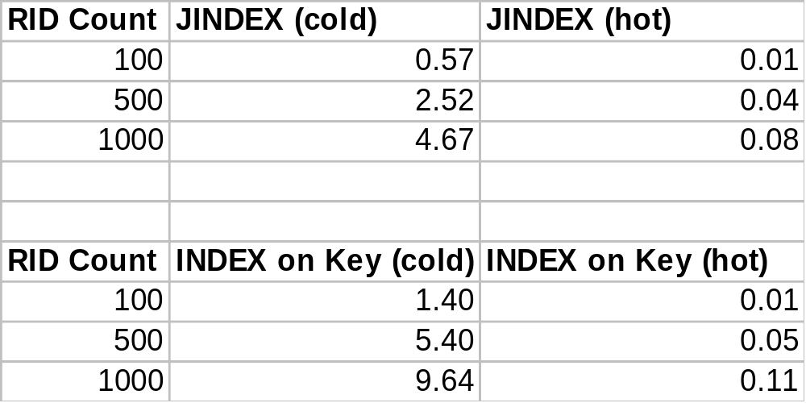
join predicates

